Slide 1
Delegate Training 2021
May 5, 2021

Slide 2
Welcome
Agenda
Governance and Operational roles
Delegate Position Description
GSHPA Delegate and National Delegate
Strategic Plan Recovery Year 1 and Year 2
Update on By Laws Task Force
Preview of revised order/index
Upcoming Dates

Slide 3
Two Kinds of Council Decision Making: Strategy / Policy and Operational
Strategy/ Policy Decisions
Fundamental, directional, and over-arching decisions.
Examples:
Examining membership strategies
Adopting a policy on diversity
Exploring Volunteer recruitment strategies

Slide 4
Two Kinds of Council Decision Making: Strategy / Policy vs. Operational
Operational Decisions
Decisions about the day-to-day implementation of strategic decisions.
Examples:
Deciding on the length of the fall product and cookie sales
Training designs and schedules to deliver
Deciding when to roll out new membership software

Slide 5
Strategy- and Policy- Influencing Opportunities
GSHPA Governance Meetings
Annual Meeting
The right to vote
Referrals for officers, board and committee positions
Serving on ad hoc committees and task groups

Slide 6
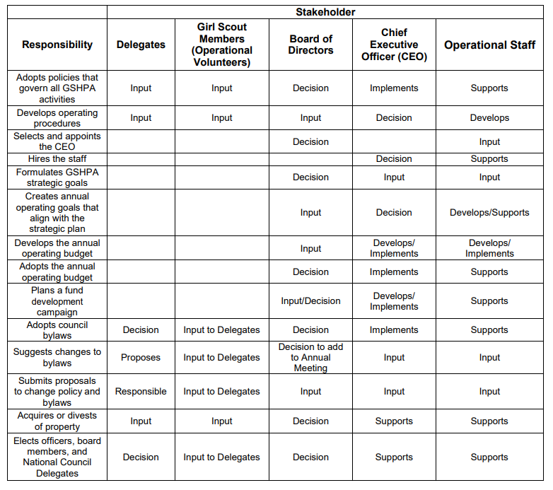
Roles and Responsibilities

Slide 7
Questions ?

Slide 8
Strategy Statement Worksheet
Movement Strategy:
Reach and Retain more girls from all communities
Council Strategy: Imperative #3
Steady Increase Membership
OPERATIONS SUBCOMMITTEE
Movement Strategy:
Transform the Volunteer Experience
Council Strategy: Imperatives #1 and 2
Recruit and Retain the Best and Brightest Volunteers and Staff
Invest in Troop Support
OPERATIONS SUBCOMMITTEE
GIRLS
VOLUNTEER
REVENUE
Movement Strategy:
Reimagine Revenue Resources
Council Strategy: Imperative #4
Develop a Financially Sustainable Business Model
FUND DEVELOPMENT/FINANCE SUBCOMMITTEES
Movement Strategy:
Relevant Brand
Council Strategy: Imperative #4
Develop a Financially Sustainable Business Model
FUND DEVELOPMENT/FINANCE SUBCOMMITTEES
Movement Strategy:
Effective Operations
Council Strategy: Imperative #1
Recruit and Retain the Best and Brightest Volunteers
OPERATIONS SUBCOMMITTEE
BRAND
OPERATIONS
Diversity, Equity, Inclusion, Access

Slide 9
Bylaws Task Force Update
Proposed by Subcommittee 3.5.2021 | Current ByLaws Index reference
ARTICLE 1. THE CORPORATION
1. Corporate Name. | A 1, S1
2. Purpose (Mission statement & area Served) | New Language
3 Membership. | A 1, S2
4. Property | A 9, S10
5. Annual Meeting. | A1 S7
a. Nominations | A1 S7
6. Special Meetings of the Corporation. | A1 S9
7. Member Proposals. | A1 S8
8. Parliamentary Authority | A11
9. Quorum | A1 S10
10. Definition of present | A12
11. Amendments | A14
ARTICLE 2. THE DELEGATES
1. Corporate Delegates
1. Composition. | A1 S3
2. Powers, Responsibilities, and Accountabilities. | A1 S6
3. Election, Term and Vacancies. | A1S5
4. Geographic Subdivisions | A1 S4
5. Voting Procedures | A1 S11
6. Quorum | A1 S10
2. National Council Delegates
1. Composition. | A8
2. Powers, Responsibilities, and Accountabilities. | A8
3. Election, Term and Vacancies. | A8

Slide 10
ByLaws TaskForceUpdate, continued
ARTICLE 3. BOARD DEVELOPMENT COMMITTEE
1. Composition. | A2S1
2. Powers, Responsibilities, and Accountabilities. | A2 S5
3. Election, Term and Vacancies. | A2 S2
4. Selection and Term of the Board Development Committee Chair. | A2 S3
5. Quorum for the Board Development Committee. | A2 S4
ARTICLE 4. OFFICERS
1. Composition. | A4 S1
2. Election, Term and Vacancies. | A4 S2
3. Powers, Responsibilities, and Accountabilities. | A4 S3
4. Removal. | A4 S4
ARTICLE 5. BOARD OF DIRECTORS
1. Composition. | A5 S2
2. Powers, Responsibilities, and Accountabilities. | A5 S1
3. Election, Term and Vacancies. | A5 S3
4. Quorum for the Board of Directors. | A5 S7
5. Regular Meetings of the Board of Directors. | A5 S5
6. Special Meetings of the Board of Directors. | A5 S6
7. Removal. | A5 S8
8. Executive Committee | A6
a. Composition. | A6 S1
b. Powers, Responsibilities, and Accountabilities. | A6 S2
c. Quorum | A6 S4
d. Meetings. | A6 S3
9. Board Committees and Task Groups | A7
a. Establishment. | A7 S1
b. Appointment and Terms of the Chair. | A7 S2
ARTICLE 6. PERSONAL LIABILITY AND INDEMNIFICATION
1. No Personal Liability. | A10 S1
2. Indemnification. | A10 S2
3. Directors’ and Officers’ Insurance. | A10 S3
ARTICLE 7. MISCELLANEOUS
1. Fiscal Year. | A9 S1
2. Contributions. | A9 S2
3. Depositories. | A9 S3
4. Approved Signatures. | A9 S4
5. Bonding. | A9 S5
6. Budget. | A9 S6
7. Audits. | A9 S7
8. Financial Reports. | A9 S8
9. Legal Counsel | A9 S9
10. Waiver of Notice Clause | A13
11. Partial Terms | A3

Slide 11
Upcoming Dates to Note
August 25, 2021 Delegate Training-Meeting 7 PM
September 25, 2021 Annual Meeting 10 AM

Slide 12
Questions ?

