Slide 1
Girl Scouts in the Heart of Pennsylvania Annual Meeting September 15, 2018

Slide 2
Girl Scout Promise
The Girl Scout Promise
On my honor, I will try:
To serve God and my country,
To help people at all times,
And to live by the Girl Scout Law.

Slide 3
Message from Sylvia Acevedo, CEO, GSUSA

Slide 4
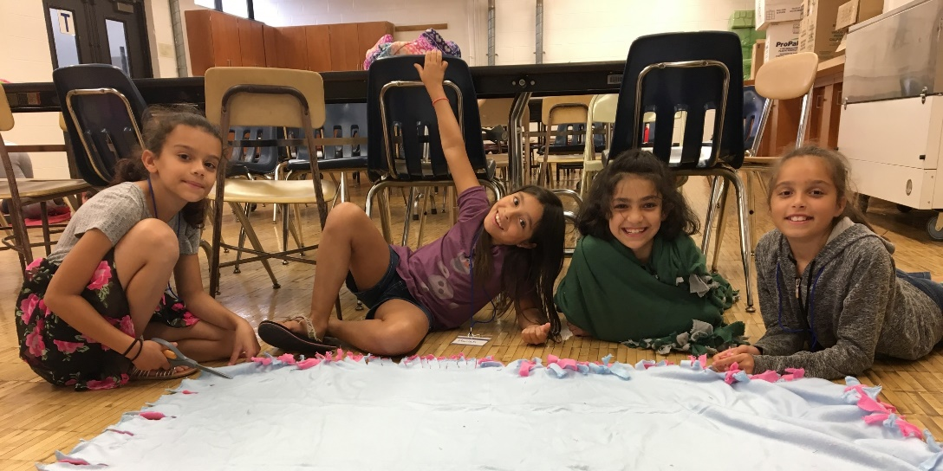
GSHPA Annual Meeting Agenda
Welcome Kathryn W. McCorkle, Chair of the Board
CEO Report
Ellen M. Kyzer, MPA, President and CEO
Financial Report
Stacy Klann, Board Treasurer
Mission Moment: STEM Expo
Quorum Report
Melinda C. Ghilardi, Esq., Board Secretary
Lebanon County Day Camp, Summer 2018

Slide 5
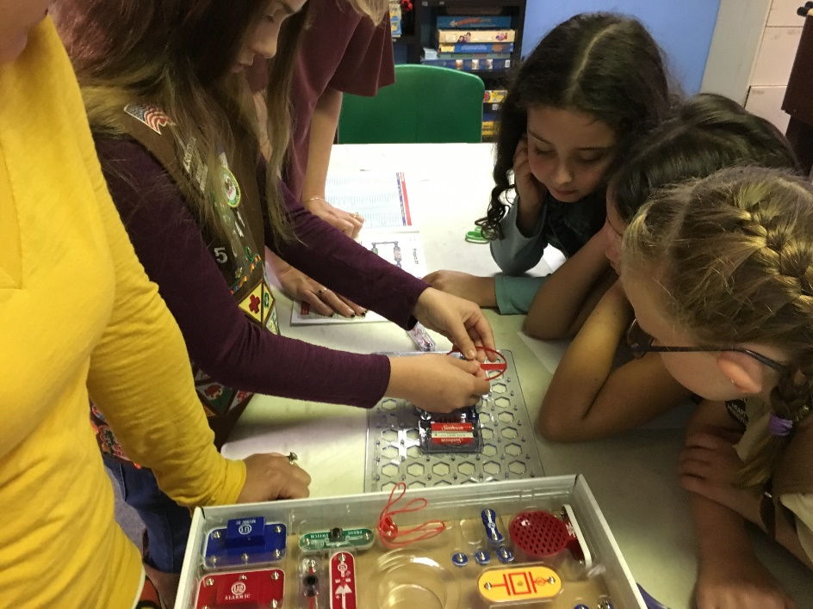
Agenda (cont.)
Presentation of the Slate and Election
Deborah Vereen, Board Development Committee Chair
Keynote Speaker
Shawn Fink Author, blogger, Abundant Mama
Adjournment
Kathryn W. McCorkle, Chair of the Board
It’s Electric! Program, October 2017

Slide 6
Introductions: Board of Directors
Chair of the Board, Kathryn W. McCorkle
Vice Chair, Deborah A. Kolsovsky
Secretary, Melinda C. Ghilardi, Esq.
Treasurer, Stacy Klann
Members-at-Large
Lynn M. Bachstein Betsy Keefer
Joanne M. Bankos Barbara G. Lyman, Ph.D.
Karen D. Best Jeshanah McLeod
Amy Brayford Nancy J. Tulli
Karen K. Deklinski Deborah Vereen
Antonio “Tony” Hernandez, Jr. Adrienne M. Vicari
Stacey O. Irwin, Ph.D. Yvette L. Willson, Esq.

Slide 7
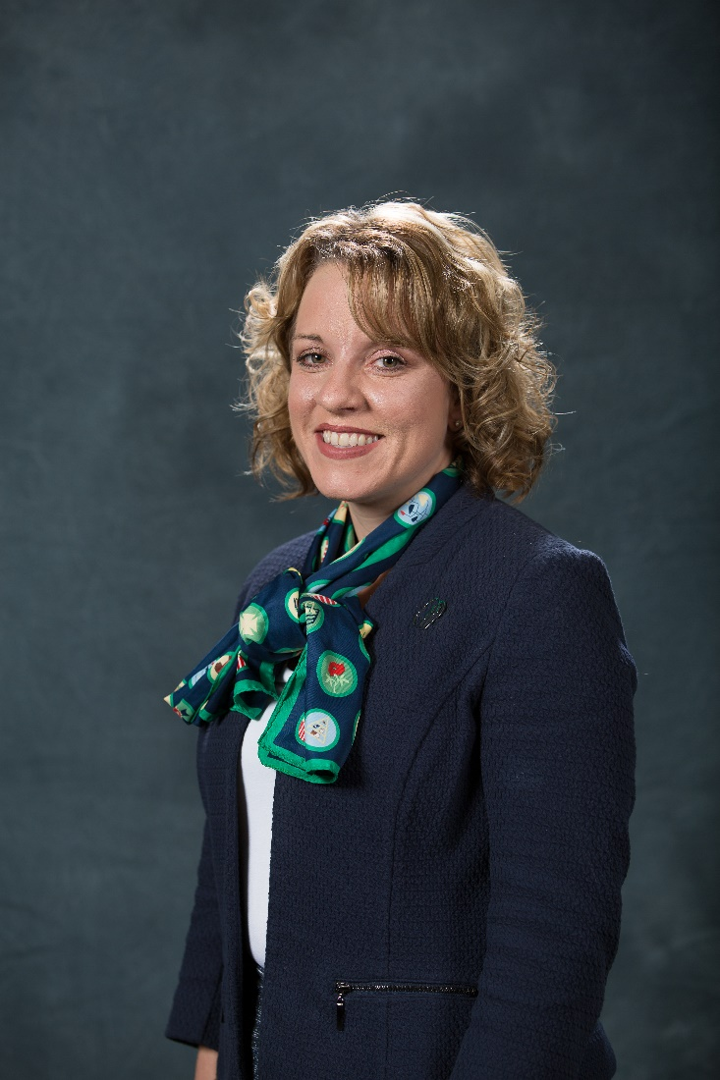
2018 Annual Meeting CEO Report
Ellen M. Kyzer, MPA
President and CEO

Slide 8
Financial Report
Stacy Klann Board Treasurer
Emily, Troop 50605, sold over 700 boxes of Girl Scout cookies in 2018

Slide 9
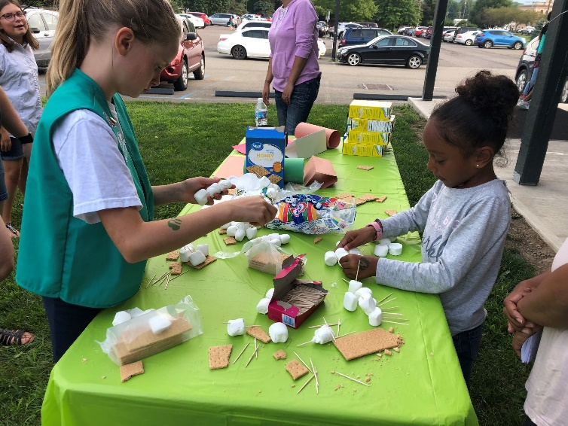
Focus on Transparency
GSHPA publishes three years of independent audit reports and IRS Form 990 online at gshpa.org
Financial statement presentation was simplified in 2017 to allow for greater insight into operating results
The Board Designated Fund was established to highlight how non-operating income is being used
Summaries of board meetings, beginning in July 2018, are published online at gshpa.org
Various analyses, such as camp property costs, are shared online at gshpa.org and through the quarterly property town hall presentations
Girls in SU516 build marshmallow towers at a recruitment event, August 2018

Slide 10
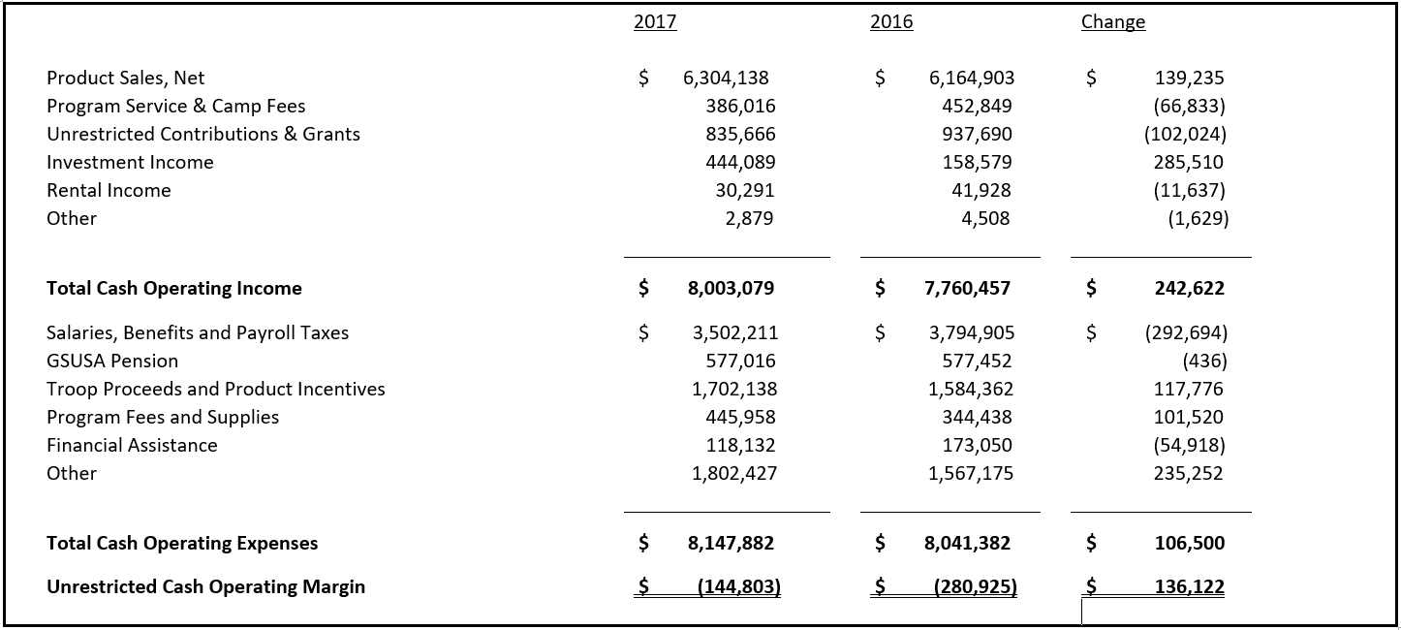
2017 Financial Report
Cash Operating Margin
Notes:
NOTES FOR USAGE:
This slide style is CONTENT PAGE BOTTOM GREEN BAR.
Avoid extensive amount of bullet points and copy–slides are meant to support the narration of the speaker.
Use the notes section of your deck for further explanation of your slides.
For slide designs with graphic options see “Layout” palette.

Slide 11
2017 Financial Report
Non-Operating Income

Slide 12
2017 Financial Report
Balance Sheet

Slide 13
2017 Financial Report
Cash Operating Reserves

Slide 14
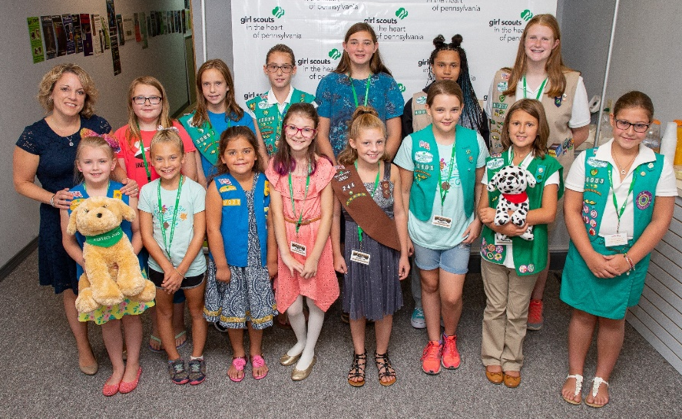
2018 Financial Highlights
gshpa
Through 10 months of 2018 –
fundraising surpassed 2017 total contributions by $210,000
$264,000 in financial assistance provided directly for girls; represents an increase of $146,000 compared to 2017 total
Product Program –
Cookie program net revenue increase of 6% compared to 2017, due to more girl members and more participation
Increase of $100,000 for troop proceeds and sales incentives
Girl Programs –
Added three full-time Program staff positions AND two mobile programming vehicles
Property Challenges –
$310,000 in forestry management expense; driven by girl safety and risk management requirements
$158,000 in non-budgeted camp and property related costs (legal fees; on-site security; vandalism repairs)
S’mores Executive Club Event, August 2018

Slide 15
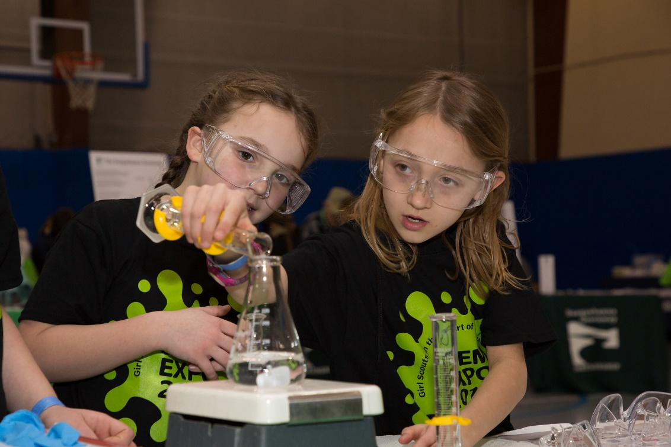
Mission Moment: STEM Expo
Penn Tech STEM Expo, February 2018

Slide 16
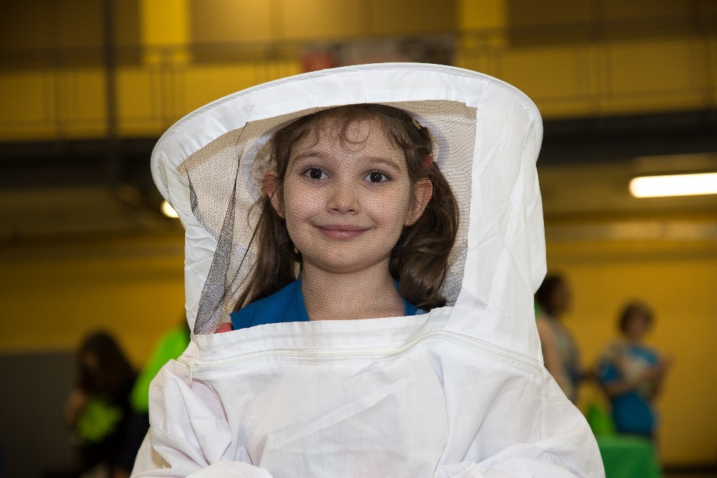
Quorum Report Melinda C. Ghilardi, Esq. Board Secretary
Millersville University STEM Expo, May 2018

Slide 17
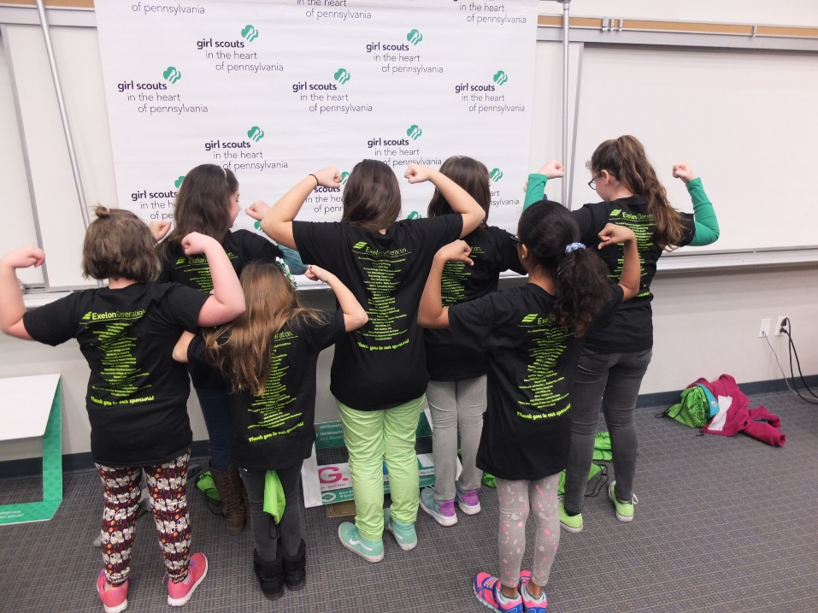
Presentation of the Slate and Election Deborah Vereen Chair, Board Development Committee
East Stroudsburg University STEM Expo, March 2018

Slide 18
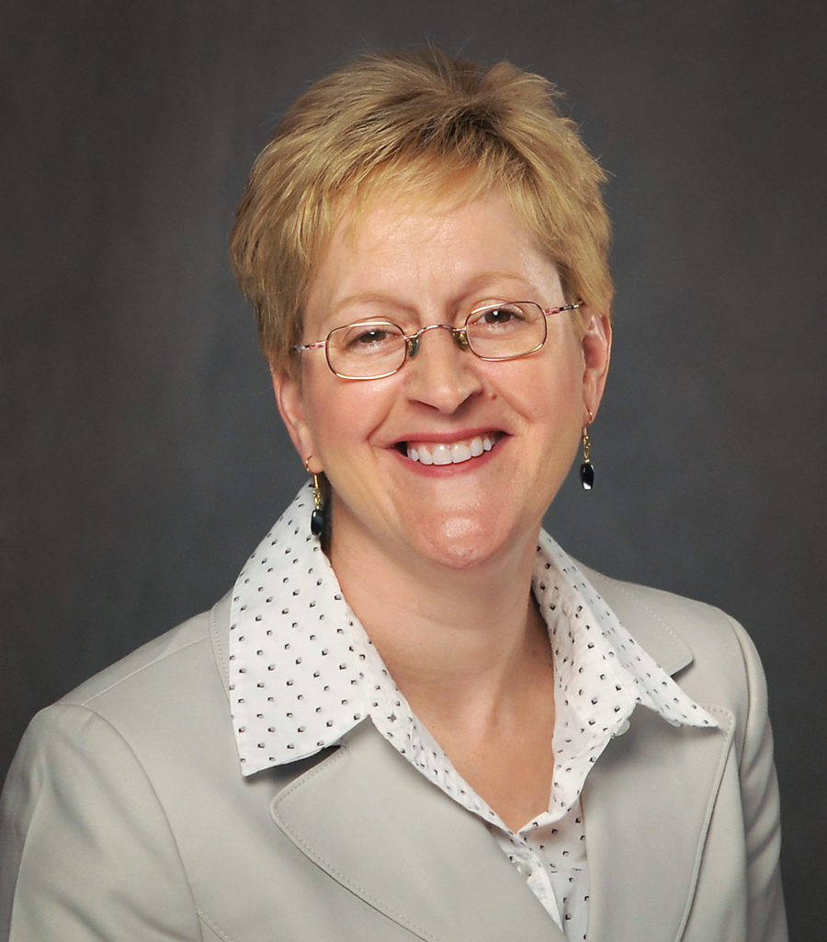
Slate of Nominees: At-Large Board Members: Second 3 Year Term
Lynn M. Bachstein, CPA, MBA ● Trucksville, PA
Lynn Bachstein has over 20 years of diverse professional development, including strategic planning, cultural lean transformation, acquisitions, financial management, human resources, and technology systems implementation. She is a passionate leader with proven ability to manage projects outside of her area of expertise, within established deadlines and budgetary requirements.
Lynn is the Director of Learning and Development at Benco Dental in Pittston. After her start in Finance, Lynn has led the National Service Division, Continuous Improvement Transformation, and Mergers and Acquisitions in her twenty-year tenure with the organization.
Lynn grew up as a girl member in Northeastern PA and credits her business savvy to the entrepreneurship skills she learned in the cookie program.
Lynn M. Bachstein

Slide 19
Slate of Nominees: At-Large Board Members: First 3 Year Term
Danna Rich-Collins is the manager of the Williamsport Office of North Penn Legal Services where she is a Paralegal and the Pro Bono Coordinator.
Danna started her professional life as a field director for the Seven Lakes Girl Scout council in Geneva, New York. While there she directed Camp Baliwick in Ithaca, NY. After leaving the Girl Scouts, Danna taught first grade in Elmira, NY. Upon moving to Pittsburgh, Danna was a youth program Director at the YWCA of Greater Pittsburgh where she served on the YWCA/Allegheny County Racial Justice Committee and was fortunate to be able to work with leaders of the community and the Civil Rights movement in initiatives to further the imperative of the YWCA: “The Elimination of Racism wherever it exists and by any means Necessary.” When Danna moved from Pittsburgh to Williamsport she joined the staff of then Susquehanna Legal Services (more recently North Penn Legal Services) and continues in that capacity today. North Penn Legal Services provides civil legal services to financially eligible individuals and families.
Danna was a Girl Scout from Brownies through Seniors. She credits girl scouting with making some of the most significant influences in her life. Highlights of her girl scouting include attending the Girl Scout Round-up in Button Bay, Vermont and earning her Curved Bar award and her camping experiences at Camp Brule. She is thankful for the influence of her leaders in developing a commitment to service, personal responsibility, respect for the environment and the importance of humor and fun. While attending Marywood College, Danna volunteered as an assistant troop leader in Dunmore.
Returning to her girl scouting roots after moving to Williamsport, Danna was a troop leader for several years and volunteered as a counselor at Camp Lycogis for troop camping weeks.
Danna served as president of the Curtin PTO in Williamsport. She was a founding member of the Domestic Violence program in Williamsport which later became affiliated with the YWCA. Danna continued with that program as a volunteer and became chairperson of the Advisory Committee for several years. She also served on the Board of the YWCA. She has served on the Lycoming County Domestic Violence Committee since its inception and co-chaired that committee for over 15 years. Other volunteer commitments include the Transitional Living Center (a halfway house for women offenders), Family Promise and Brandon Little League.

Slide 20
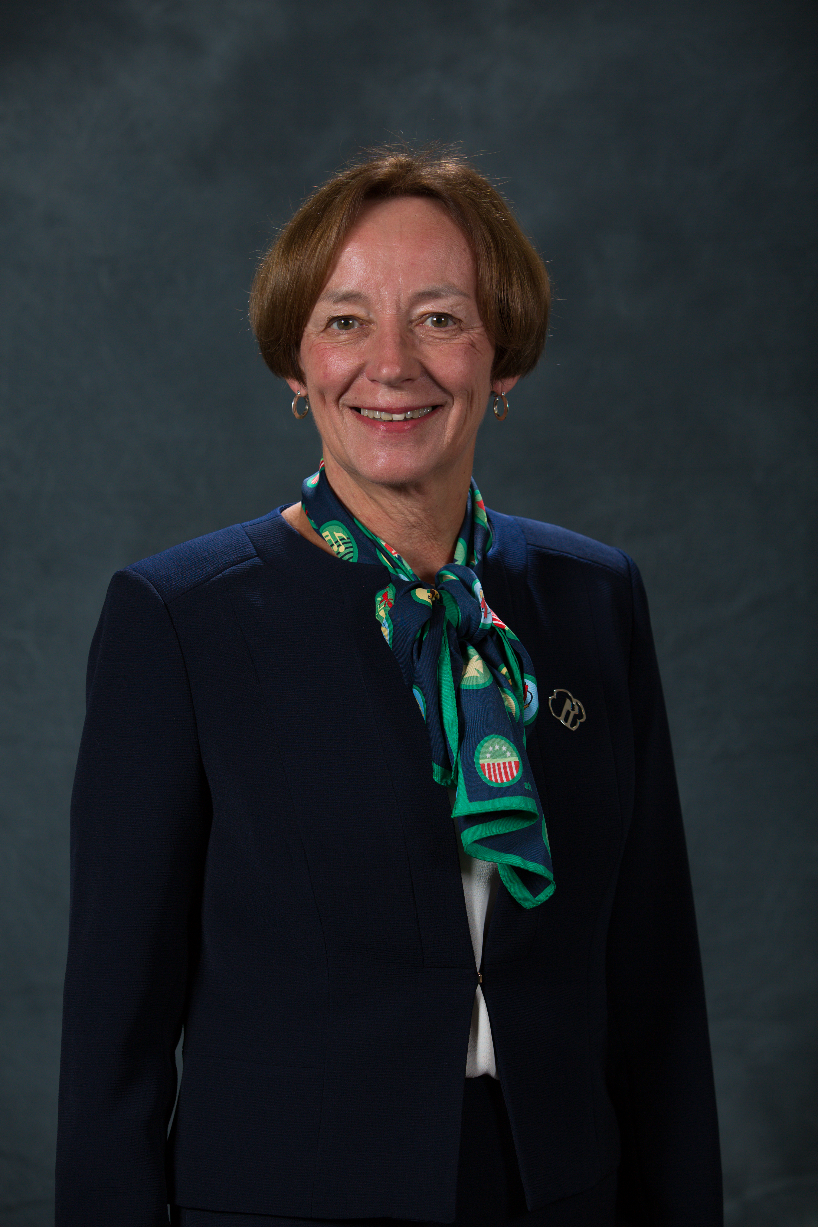
Slate of Nominees: Officers Chair of the Board of Directors: 2 year term
Kathy retired from her position of Executive Director of the Historical Society of Dauphin County in April 2013. She coordinated and facilitated fundraising efforts, special projects and events, including raising funds for and managing property maintenance and improvements. Prior to joining the Historical Society, Kathy served as CEO of the YWCA of Greater Harrisburg and worked as an administrator and teacher at the Harrisburg Academy for 15 years. She was recently honored by the YWCA of Greater Harrisburg at the 25th Annual Tribute to Women of Excellence Class of 2014 as a Legacy Honoree.
Kathy was a Girl Scout from Brownies through Senior Scout (1954 through 1964). She left Girl Scouts prior to her senior year in high school, but she did have one heck of a badge sash! She was a Girl Scout Camp CIT in 1964, a unit counselor in 1965, waterfront counselor in 1966, and waterfront director at Camp Lycogis in 1967, as well as a day camp leader one year and an overnight trip leader another year when her daughter was in scouting.
Kathryn W. McCorkle,
Chair of the Board

Slide 21
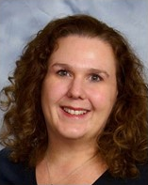
Slate of Nominees: Board Development Committee 2 year term
Dr. Stacey O. Irwin is a Professor at Millersville University of Pennsylvania, where she teaches a variety of digital media production, writing, and theory classes in the Media and Broadcasting program in the Department of Communication and Theatre. Prior experience includes time as a radio announcer and media producer.
Stacey received a doctorate in Education from the University of Maryland College Park, a Master of Arts degree from Emerson College, and a Bachelor of Science degree from Salem College, West Virginia.
Stacey was a Girl Scout troop leader for nine years and volunteered at Foxfire House at Camp Furnace Hills. She received her Gold Award and First Class Award while a Girl Scout in Lancaster County and later served on the Gold Award Scholarship Committee.
Stacey O. Irwin, Ph.D.

Slide 22
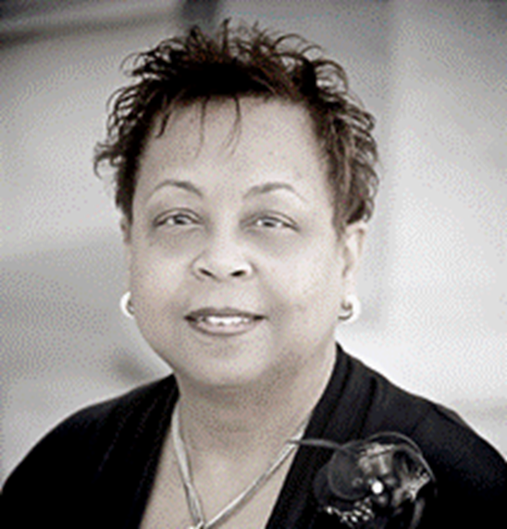
Slate of Nominees: Board Development Committee 2 year term
Deborah is a certified master trainer and facilitator whose areas of expertise comprise Strategic Planning, Leadership Coaching, D&I Training & Development, Holistic Recruitment (Retention), Community Engagement, Employee Business Resource Groups, and Diversity Metrics, Reporting & Analytics. She is one of a select few in the nation who has earned the unique credential status of CCDP/AP (Cornell Certified Diversity Professional/Advanced Practitioner) from Cornell University.
Prior to transitioning to the private sector, Deborah was the Sr. Director of Organizational Effectiveness and Diversity (OE&D) for AHOLD/GIANT Food Stores. She designed and directed the effective integration of inclusionary practices into every area and discipline of the business by focusing on Workforce Development, Sales & Marketing, and Community Engagement. She established AHOLD’s first Female Leadership Advisory Council and Multicultural Employee Business Resource Group. As a result, she brings a bottom line perspective to the discipline of Diversity and Inclusion. Many Community, Business, Education, and Government entities have tapped into Deborah’s “hands on” experience in Operations and Corporate.
Deborah is co-founder of the Diversity & Inclusion Professionals of Central PA (DIPCPA). She currently serves on the Board of Directors of Girl Scouts in the Heart of Pennsylvania (GSHPA), and the Diversity Advisory Council of the Human Resource Professionals of Central PA (HRPCPA). Deborah is the proud grandmother of two Girl Scouts.
Deborah is the recipient of numerous awards and recognitions. In 2010, she was recognized as one of the most “Influential Inclusion Leaders” of Central PA. In 2011, Deborah received the Business Diversity Champion Award from the Harrisburg Regional Chamber & CREDC. In 2014, she was invited to offer testimony before the bipartisan Labor & Industry Committee of the Pennsylvania Legislature regarding pay equity for women. And in 2017, she received the Leadership in Diversity Award from The Conference For Women.
Deborah D. Vereen, CCDP/AP

Slide 23
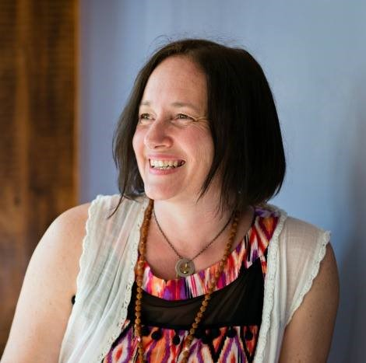
Keynote Speaker Shawn Fink

Slide 24
Adjournment
Kathryn W. McCorkle
Chair of the Board

Slide 25
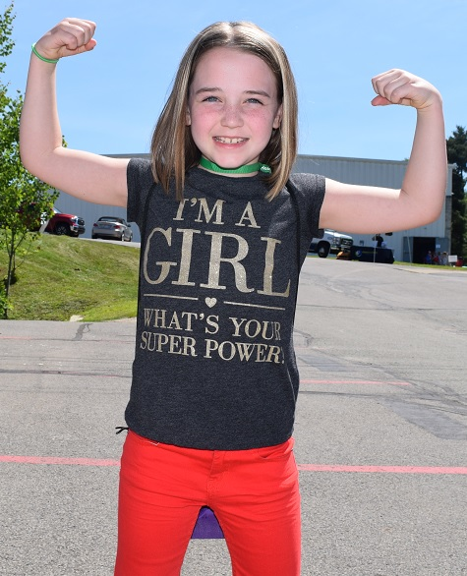
Thank you for attending!
GIRL Con, Scranton, June 2018

